Slide 1
Germany University Database
Extraction of the Data and Creation of MySQL Database of the Universities in Germany using Python and its Libraries
By Neha Thakar

Slide 2
Table of Contents
Data Scraping
Data Extraction
Data Handling
Data Cleaning
Data Visualization
Create Database in MySQL
Data transfer to Database

Slide 3
Data Scraping
Data Extraction
Scraping the List of the universities in Germany using the ‘BeautifulSoup’ package
https://en.wikipedia.org/wiki/List_of_universities_in_Germany
The list was saved for further scraping of data of the universities
For each university, 'https://en.wikipedia.org' + university
Each ‘url’ was then passed to get the data using ‘BeautifulSoup’ , pertaining to university was extracted and stored in the form of ‘dictionary’

Slide 4
Data Handling
Data Cleaning
The keys in the dictionary were the ‘columns’ and all the ‘dictionaries’ were made to hold the same number of ‘keys’
The missing information for the dictionary- key was assigned ‘null’ value
Collected data was having duplicates, spelling errors etc
Removing all irrelevant ‘columns’ and information
Cleaning numerical columns to make it pure int/float

Slide 5
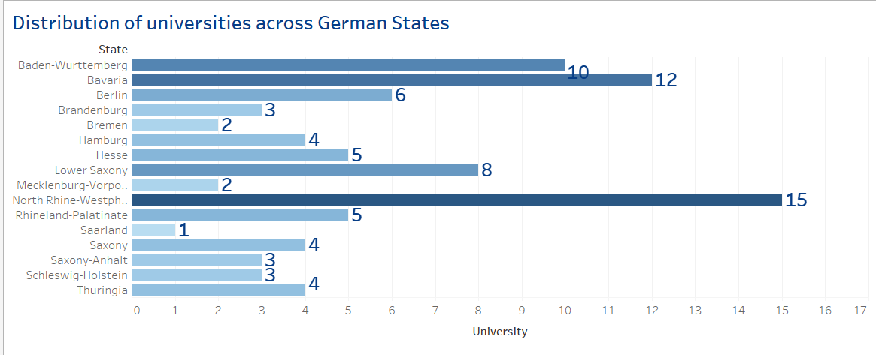
State-wise ---- Universities in Germany

Slide 6
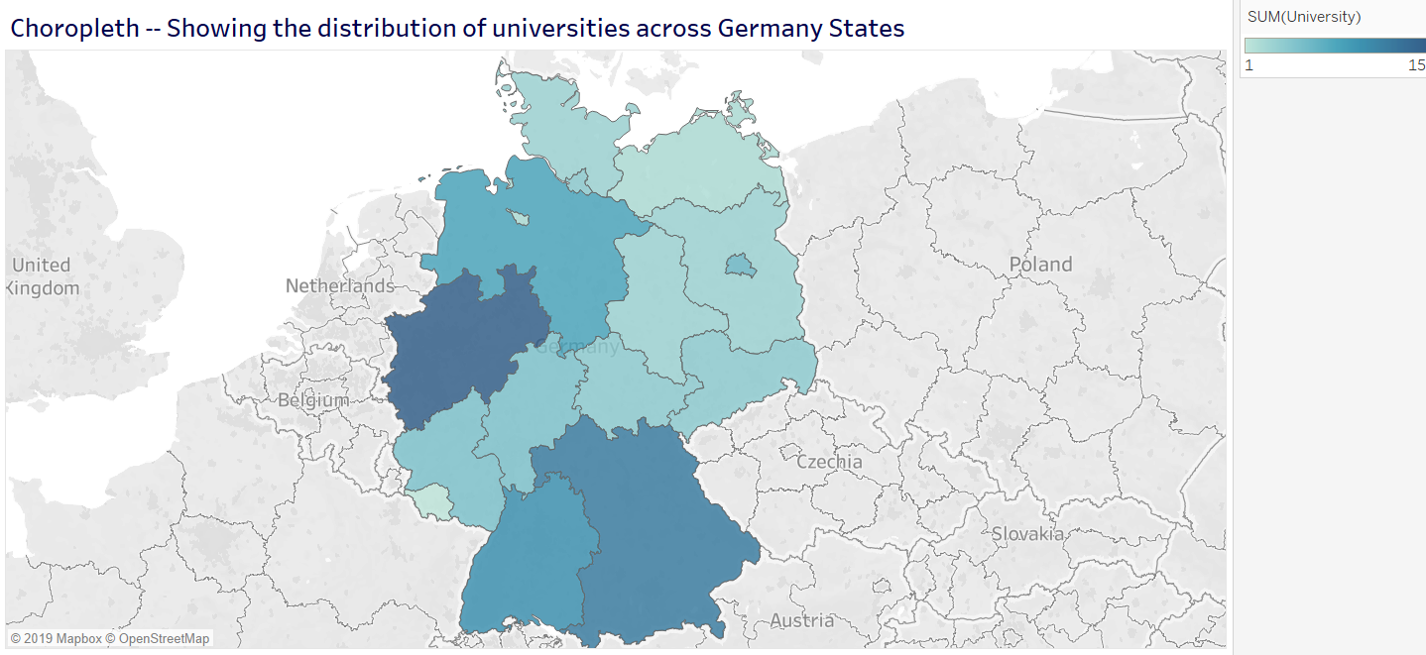
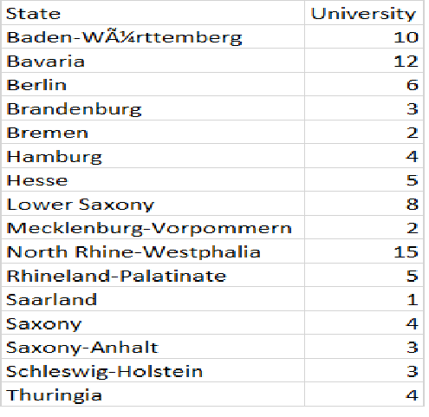
Choropleth --- Variation of Universities in each State

Slide 7
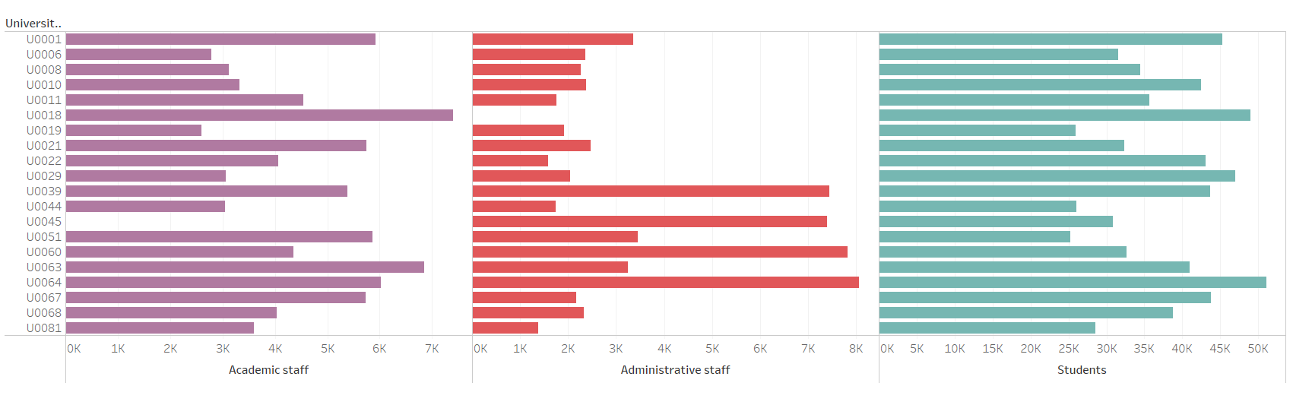
Academic/Administrative staff and Students distribution of Top 20 Universities with high Budget

Slide 8
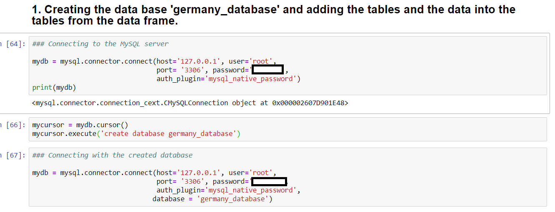
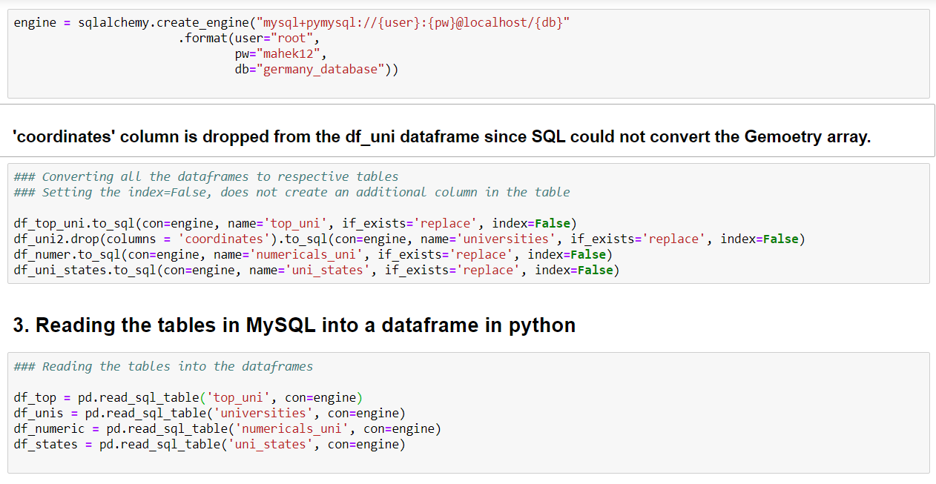
MySQL Database ---- Using Python

Slide 9
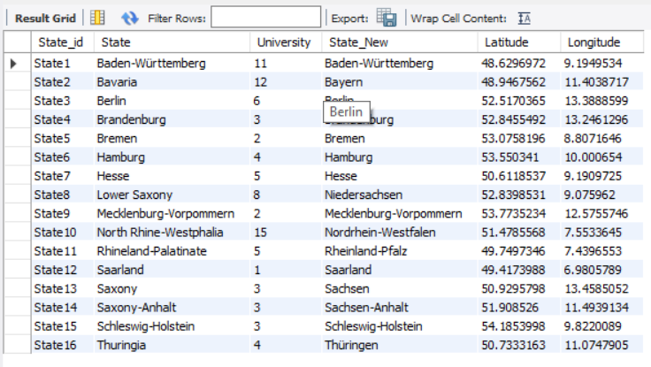
MySQL Table View

Slide 10



Thankyou for Watching
https://www.linkedin.com/in/neha-thakar-2019/
SourceL CC BY-SA
https://public.tableau.com/profile/neha.thakar#!/
SourceL CC BY-SA
https://github.com/NehaThakar/Germany_University_Database
SourceL CC BY-SA

